Slide 1
INTEL IMAGE CLASSIFICATION
APOORVA GEETANJALI AVADHANULA, STUDENT ID -1
TEJASWI AYYADAPU, STUDENT ID-2
HIMA BINDU VATSAVAYI, STUDENT ID- 41

Slide 2
INTRODUCTION
The Image Classification problem, which is the task of assigning an input image one label from a fixed set of categories. This is one of the core problems in Computer Vision that, despite its simplicity, has a large variety of practical applications.
Computer Vision tasks can be reduced to image classification.
There are potentially n number of categories in which a given image can be classified.
Example - Self-driving cars.

Slide 3
MOTIVATION
There is a necessity to classify images to keep them organized. We do the Intel image classification in order to categorize them into 6 categories mainly-
Buildings
Forests
Glacier
Mountain
Sea
Street

Slide 4
DATSET DESCRIPTION
This project needs image data of Natural Scenes around the world. This Data contains around 25k images of size 150x150 distributed under 6 categories.
{‘buildings’ - 0, ‘forest’ – 1, ‘glacier’ – 2, ‘mountain’ – 3, ‘sea’ – 4, ‘street’ – 5}
The Train, Test and Prediction data is separated in each zip files.
Training data has 14k images
Test data has 3k images
Want to build powerful Neural network that can classify these images with more accuracy.

Slide 5
PROPOSED SOLUTION
The conventional approach to Image Classification consists of two steps:
First is to generate meaningful features of an image.
To classify image based on features.
This uses simple models such as Support Vector Machine (SVM), K-nearest neighbor, logistic regression.
There is an alternative approach found using the Convolutional Neural Network.
In our project, we used the Convolutional Neutral network to classify images i.e., to categorize them.

Slide 6
CONVOLUTIONAL NEURAL NETWORK
The common CNN architecture consists of the following parts:
Convolutional layers
Pooling layers
Dense (fully-connected) layers
A CNN
starts with an input image
applies many different filters to it to create a feature map
applies a ReLU function to increase non-linearity
applies a pooling layer to each feature map
flattens the pooled images into one long vector.
inputs the vector into a fully connected artificial neural network.
processes the features through the network. The final fully connected layer provides the
“voting” of the classes that we’re after.

Slide 7
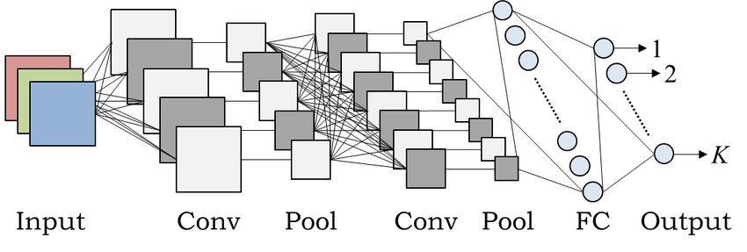
CNN ARCHITECTURE
A classic CNN architecture would look something like this:
Input -> Convolution -> ReLU -> Convolution -> ReLU -> Pooling -> ReLU -> Convolution ->ReLU -> Pooling -> Fully Connected.

Slide 8
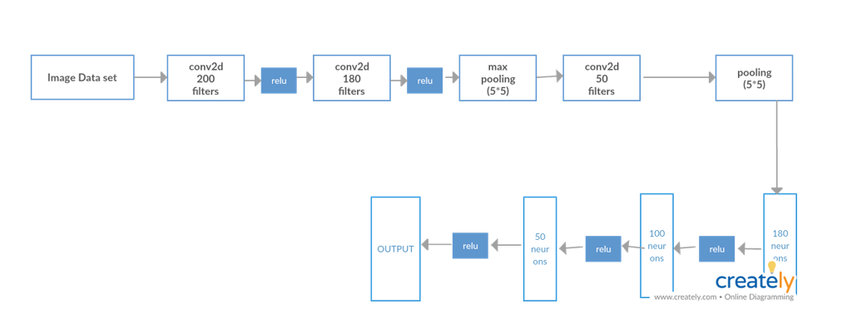
SYSTEM ARCHITECTURE

Slide 9
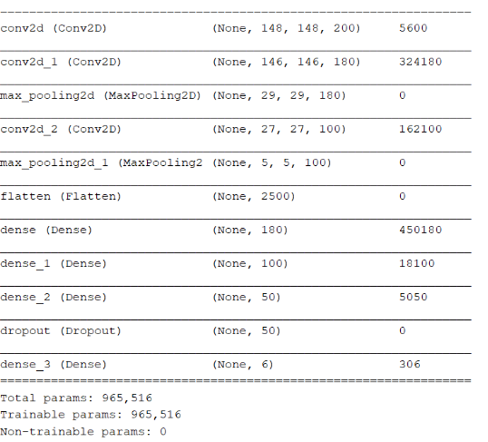
EVALUATION RESULTS
DENSE LAYER OVERVIEW:

Slide 10
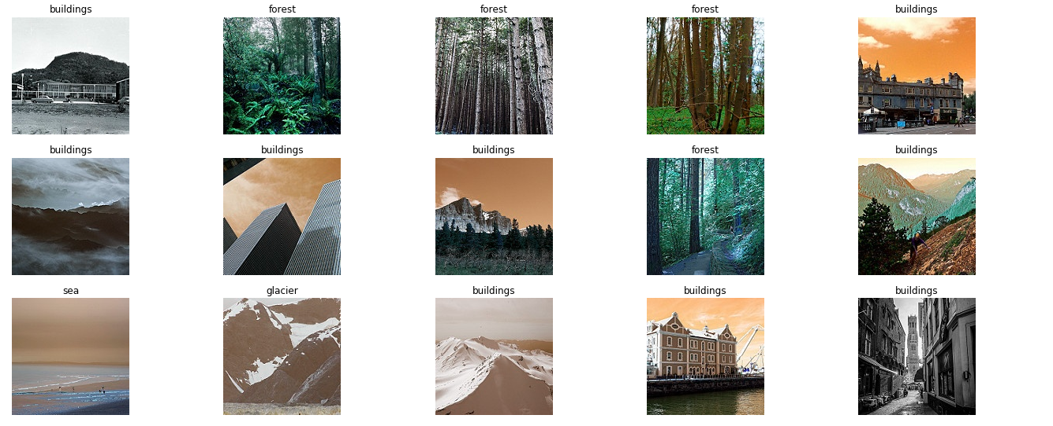
TEST DATA OUTPUT

Slide 11
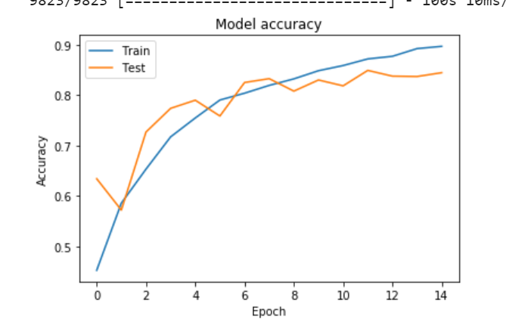
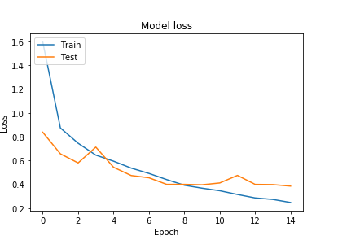
ACCURACY AND LOSS GRAPHS
ACCURACY LOSS

Slide 12
FUTURE WORK
We can further classify the images into subclasses by identifying the objects in the images belonging to one class and grouping all of them into a new sub clases.

Slide 13
THANKYOU

